Slide 1

Resume Ranking Using Machine Learning

Slide 2
Introduction
Project Overview: This project aims to develop a machine learning algorithm for ranking resumes based on job descriptions.
Problem Statement: Traditional resume screening can be time-consuming and subjective. Automating this process can save time and improve efficiency.
Dataset: We utilized a dataset comprising 1574 resumes

Slide 3
Job description considered:
Looking for a full stack developer proficient in Python, JavaScript, and Django. Must have experience with machine learning and deep learning projects. A degree in Computer Science or related field is preferred.

Slide 4
Data Preprocessing
Cleaned and prepared the resumes dataset by handling missing values and formatting issues.
Combined fields such as name, degree, skills, etc., into a single cohesive text representation for each resume.
Applied preprocessing techniques including tokenization, stop word removal, and lemmatization to normalize text data.
Applied similar preprocessing steps to job descriptions to ensure consistency in text processing.

Slide 5
TF-IDF Vectorization
Term Frequency-Inverse Document Frequency (TF-IDF) is a numerical statistic that reflects how important a word is to a document in a collection or corpus. It helps in identifying unique words that differentiate documents.
Implementation:
Utilized TfidfVectorizer from scikit-learn to convert text data into TF-IDF vectors.
Fitted and transformed both resumes and job descriptions into TF-IDF matrices for further analysis.

Slide 6
Cosine Similarity
Cosine similarity measures the cosine of the angle between two non-zero vectors. In this project, cosine similarity was employed to quantify the similarity between the TF-IDF vectors of the job description and each resume.
Application:
Computed cosine similarity scores to rank resumes based on how closely they match the job description.
Higher scores indicate resumes that are more relevant to the job requirements.

Slide 7
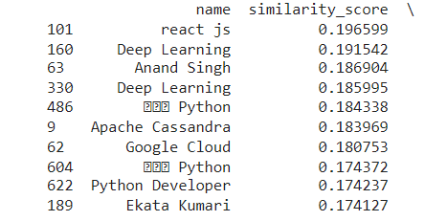
Results
Ranked Resumes:
Presented a sample of top-ranked resumes based on a specific job description.
Displayed names of top candidates along with their similarity scores indicating relevance to the job.

Slide 8
Thank you

